Slide 1

Overview of Microcomputer
Structure and Operation
Department of Computer Science & Engineering BRAC University.
Course ID: CSE - 341
Course Title: Microprocessors

Slide 2
Block Diagram of a Microcomputer
Components of Microcomputer:
CPU (Microprocessor)
Memory (RAM, ROM etc.)
I/O
System Buses:
Address bus
Data bus
Control bus
Address bus
CPU
ROM
RAM
I/O
interface
I/O
devices
Data bus
Control bus

Slide 3
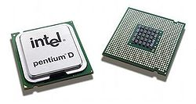
CPU - Central Processing Unit
FETCH : Take in binary-coded instructions from memory
DECODE : Analyze or make sense of the instructions
EXECUTE : Carry out the instructions
Controls overall operation of the computer
Important components: Registers , ALU , Control Unit
Pentium D dual core processors

Slide 4
Memory
This is where all the binary coded instructions and data are stored. Example: ROM, RAM etc.
RAM (Random Access Memory) :
Can be read and written to anytime by the CPU.
It is volatile memory. That means contents of RAM are erased when the power to the computer is turned off.
ROM (Read Only Memory) :
Can only be read by the CPU.
It is pre-loaded with data and software that never changes like computer's initial start-up instructions.
It is non volatile memory. That means contents of ROM are NOT erased when the power to the computer is turned off.

Slide 5
I/O Unit
Input/output (I/O) units serve as a medium of communication between the user and the computer.
Inputs are the signals or data received by the system, and outputs are the signals or data sent from it.
Devices that provide input or output to the computer are called peripherals.
For example:
keyboard, mouse (input)
display, printer(output)
hard disk (both input and output)

Slide 6
System Bus
System bus is made up of three types of bus :
Address Bus
Data Bus
Control Bus
WRITE operation : When data is written onto memory location or an I/O port by the processor
READ operation : When data is read from a selected memory location or an I/O port by the processor

Slide 7
Address Bus
Carries memory address of the instructions which are to be executed
Information transfer takes place from the processor to the memory or I/O elements.
That is why address bus is Unidirectional.
Size is generally16, 20, 24, 32 or 36 bits.
The number of locations that the CPU can address is determined by the size of address bus
8086 processor has 20 bit address bus
For example : microprocessor with 32 bit address bus can
address 2³² memory locations

Slide 8
Data Bus
It is used to carry data.
It is a bidirectional. That means data can flow in both to or from the microprocessor.
The size of the data bus varies from one microprocessor to another.
Usually matches the word length of the microprocessor
Size is generally 8,16, 32 or 64 bits

Slide 9
Control Bus
It carries timing and control signals generated by the CPU that are used to synchronize operation of the individual microcomputer elements.
It can carry many different signals. For e.g.
I/O Read
I/O Write
Interrupt
Memory read
Memory write

Slide 10
Fetch & Execute Cycles
The Fetch & Execute Cycle of the CPU is composed of three basic operations :
Fetch
Decode
Execute
Fetch :
The instruction required from memory is stored or copied in the instruction register.
Increments the program counter so that it points to the next instruction.

Slide 11
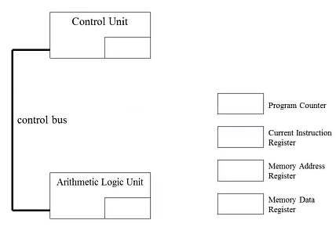
The CPU’s Special Purpose Registers
Program Counter : Holds address of next instruction
Instruction Register : Holds the instruction currently being executed or decoded
Memory Address Register : Holds memory address from where data will be fetched
Memory Data Register : Holds the data being transferred to the memory or from the memory by the CPU

Slide 12
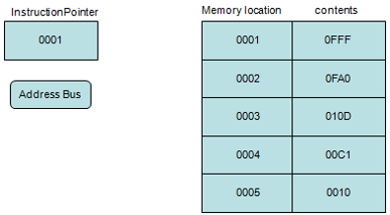
Fetching an Instruction
Step 1
Program Counter or instruction pointer (IP) is a register that holds the address of the next instruction to be fetch.

Slide 13
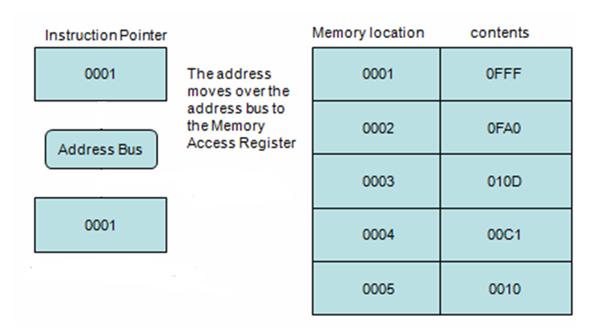
Fetching an Instruction
Step 2
The address moves over the address bus to the Memory Address Register
Memory Address Register

Slide 14
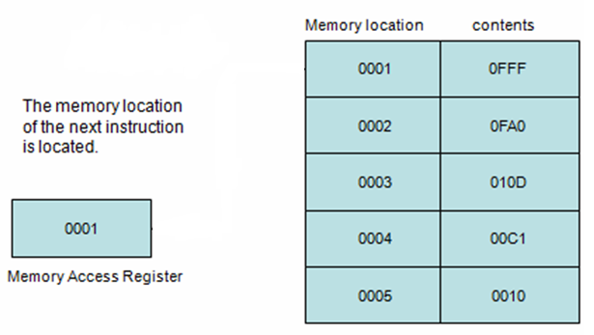
Fetching an Instruction
Step 3
Memory location of the instruction is located
Memory Address Register

Slide 15
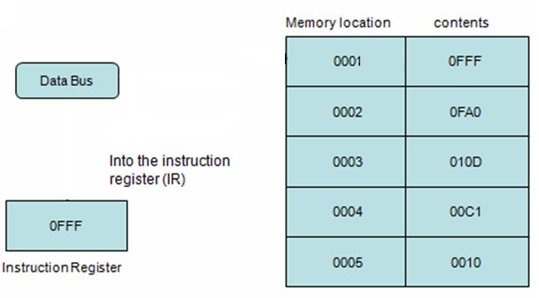
Fetching an Instruction
Step 4
Memory Data Register

Slide 16
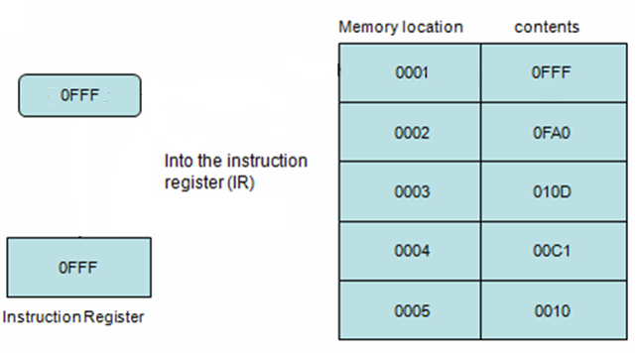
Fetching an Instruction
Step 5
Memory Data Register

Slide 17
Food for thought
What do you mean by a 32 bit Data Bus ?
BIOS is a special program that orchestrates loading the computer's operating system. Should it be stored in ROM or RAM ?

